Slide 1

Room Management
Microservices System
A Distributed Room Reservation Platform
Scala 2.13 Play Framework 2.9.1 Akka Classic 2.8.5 Kafka 3.6.1 MySQL 8.0
Presenter: [Your Name]
Date: [Current Date]

Slide 2


Problem Statement & Solution
Business Challenges
Our Solution
• Manual room booking processes cause inefficiency.
• Distributed microservices architecture.
• No automated notifications for meetings.
• Real-time room availability system.
• Lack of real-time availability checking.
• Automated notification system.
• Poor resource utilization due to no-shows.
• Event-driven communication via Kafka.
• Scalability issues with monolithic systems.
• Scalable and fault-tolerant design.

Slide 3
System Architecture
🏢 Room Management Service
• Play Framework + REST API
• MySQL database integration
• Kafka message producer
• Port: 9000
📧 Notification Service
• Akka Classic actors system
• Kafka message consumer
• Email notification processing
• Standalone JAR application
Async Communication via Apache Kafka

Slide 4




Technology Stack
Backend Frameworks
Data & Messaging
Development
• Play Framework 2.9.1: RESTful API service.
• MySQL 8.0: Persistent data storage.
• Docker Compose: Local environment.
• Apache Kafka 3.6.1: Event streaming.
• Akka Classic 2.8.5: Actor-based processing.
• SBT: Build & dependency tool.
• Slick ORM: Database access layer.
• Scala 2.13: Programming language.

Slide 5

Room Service API
REST API Endpoints
Key Features
• Real-time availability checking
• Automated reminder processing
• Auto-release for unused rooms
• Kafka event publishing
• Database transaction management

Slide 6


Notification Architecture
Akka Classic Design
• NotificationProcessorActor: Main logic with Props factory.
• EmailService: SMTP integration.
• KafkaConsumerService: Message consumption.
Processing Flow
1.
Consume Kafka messages
2.
Route to appropriate actors
3.
Process business logic
4.
Send email via SMTP
5.
Log administrative events
Benefits:
Supervision hierarchies & Props-based instantiation.

Slide 7

Event-Driven Communication
Topic Name | Producer | Consumer | Purpose
room-preparation-notifications | Room Svc | Notify Svc | Room setup alerts
reservation-reminder-notifications | Room Svc | Notify Svc | Meeting reminders
room-release-notifications | Room Svc | Notify Svc | Auto-release
admin-notifications | Room Svc | Notify Svc | Admin events
Architecture Benefits: Decoupled scaling, Asynchronous processing, Event sourcing, Fault tolerance.

Slide 8
Database & Data Flow
MySQL Schema
• Rooms: Info, capacity, equipment.
• Reservations: Booking details, status.
• Indexes: Optimized for time queries.
Data Flow Process
1.
API Request -> Validation
2.
Logic -> Availability check
3.
DB Update -> MySQL Transaction
4.
Publish -> Kafka Notification
5.
Delivery -> SMTP Email

Slide 9




Smart Business Features
Smart Reminders
Auto-Release
Real-Time Logic
• 15-minute advance alerts.
• 15-min grace period.
• Conflict detection.
• Configurable intervals.
• Resource optimization.
• Capacity validation.
• Calendar integration.
• Real-time updates.
• Slot optimization.

Slide 10
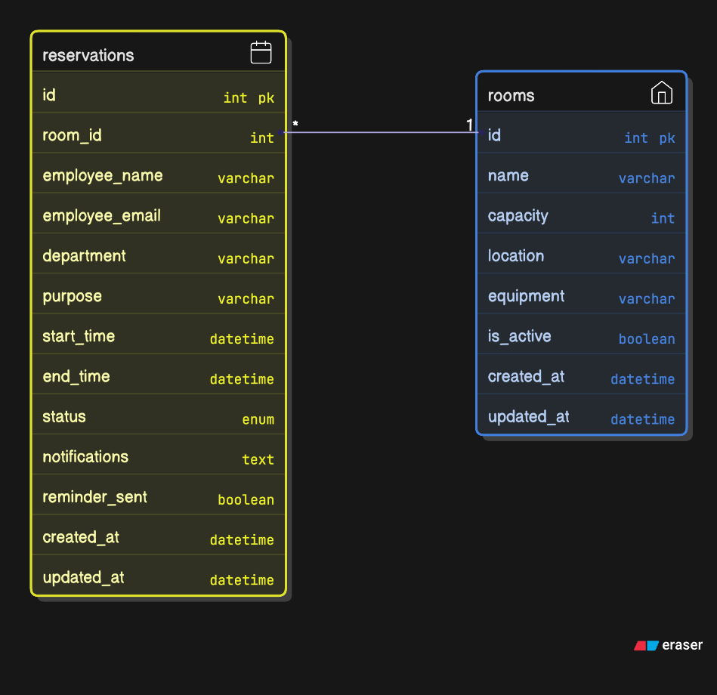
Employee Makes Reservation
↓
API Request to Room Service
↓
JWT Auth Validated (Future)
↓
ReservationController Validates Input
↓
ReservationService Applies Business Logic
↓
Room Availability Check
↓
DB Transaction Insert (Serializable)
↓
Kafka Events Published
↓
Success Response Sent
↓
Notification Service Consumes
↓
Email Notifications Sent
Database & Architecture

Slide 11


Scalability & Future
Current Scalability
Planned Enhancements
• Horizontal: Multiple instances.
• Security (JWT/OAuth2)
• Balancing: Distributed requests.
• Real-time Analytics
• Clustering: High-availability MySQL.
• Mobile Integration
• Partitioning: Parallel processing.
• Cloud Native (K8s)

